Slide 1
From book 8 important formulas

Slide 2
Bayesian equasion
Betting equasion
Confidence equasion

Slide 3
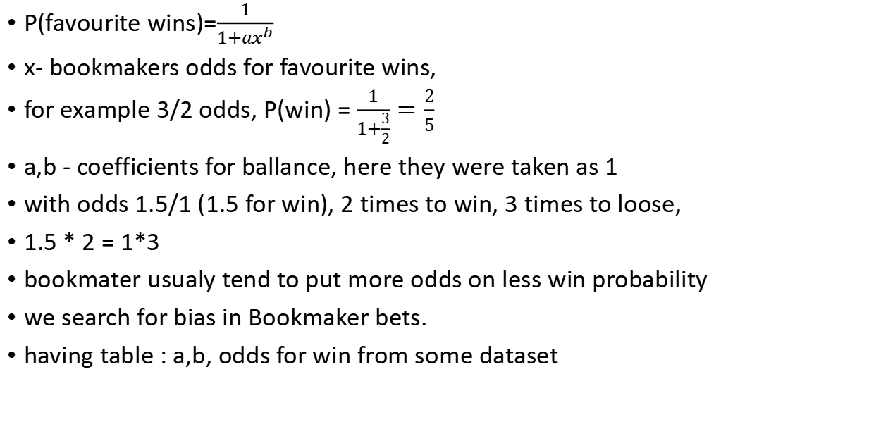
Betting equasion
P(favourite wins)=$\frac{1}{1+ax^{b}}$
x- bookmakers odds for favourite wins,
for example 3/2 odds, P(win) = $\frac{1}{1+\frac{3}{2}}=\frac{2}{5}$
a,b - coefficients for ballance, here they were taken as 1
with odds 1.5/1 (1.5 for win), 2 times to win, 3 times to loose,
1.5 * 2 = 1*3
bookmater usualy tend to put more odds on less win probability
we search for bias in Bookmaker bets.
having table : a,b, odds for win from some dataset

Slide 4

Confidence equasion
$hn±1.96σ\sqrt{n}$ where
h - signal
$σ$ - noice
n - number of trials
it comes from normal distribution
maybe from central limit theorem - ?

Slide 5

The skill equasion / markov provess ?
$P(S_{t+1}|S_{t})=PP(S_{t+1}|S_{t},S_{t+1}...)$

Slide 6

The influence equasion
$Aρ_{∞}=ρ_{∞}$ where
$A$ + connectivity matrix, 0 in diagonals (not nessesary, you may describe somehow how current person,s opinion influence on himself)
$ρ_{∞}$ vector of opinions , is changing until ballance ( something like ValueIteration or Leontiev Matrix)

Slide 7
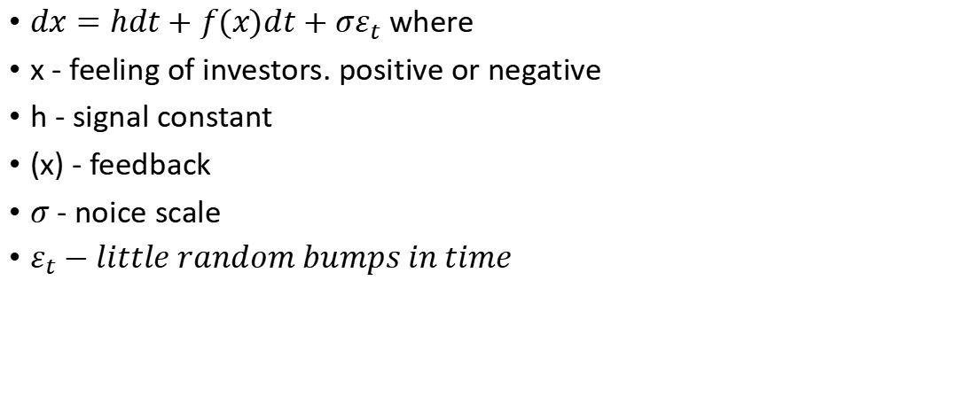
Market Equasion
$dx=hdt+f(x)dt+σε_{t}$ where
x - feeling of investors. positive or negative
h - signal constant
(x) - feedback
$σ$ - noice scale
$ε_{t}−little random bumps in time$

